Slide 1
Ruby Training: Arrays and Hashes
Matthew Eakin, Manager
Managed Testing Practice
Sogeti, USA
Matthew.Eakin@us.sogeti.com

Slide 2

Course Agenda
What are Arrays and What are Hashes?
Arrays
Types of numbers in Ruby
Arithmetic in Ruby
Hashes
What is a string
Expression substitution
Escape (non-printable) characters
Referencing Strings
Removing white spaces from Strings
Other fun String methods
Add a “arrays.rb” file to the Strings Project

Slide 3
What is an Array?
Definition: ordered, integer-indexed collections of any object
Each element in an array is associated with and referred to by an index
Array indexing starts at 0
In the below example, the array element in slot 2 (farm_array[2]) is “goat”
Index | Index | Index | Index | Index
0 | 1 | 2 | 3 | 4
cat | dog | goat | pig | fish

Slide 4
What is a Hash?
Definition: a collection of key-value pairs like this: "employee" => "salary“
Similar to an Array, except that indexing is done via arbitrary keys of any object type, not an integer index like an Array
Sometimes called an associative array
Keys are unique
In the below example, the hash element in slot “Corrie” (employee_salary[“Corrie”]) is “20,000”
KEY: | Scott | Corrie | Matt | Gary | Raphael
VALUE: | 10,000 | 20,000 | 30,000 | 40,000 | 50,000

Slide 5
Creating an Array
Arrays can be created with a simple “new” method:
Array.new
You can also create Arrays using literal notation:
[string1, string2, …] #this is not recommended in the Ruby Style Guide
Or you can also create Arrays using the “%w” method for strings:
%w(string1 string2 …) #this is recommended in the Ruby Style Guide
You can optionally specify the size of the array when creating it:
Array.new(20)
How big is the Array?
Array has a “size” method you can use to determine the size of the array:
new_array.size

Slide 6
Adding to the Array
You can build an Array when you create it:
Array.new(4, ”dogs”)
Or as you go:
new_array[0] = “c"
new_array[1] = "a"
new_array[2] = “t“
Another way to add an object to an array is the “<<“ operator. It will add the object to the end of the array:
new_array << “d”

Slide 7
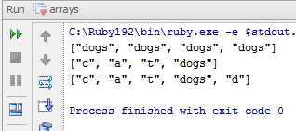
Viewing the Array
If you were to use “puts new_array” you would see the full Ruby Array, not just the array values
To display the values in an array you need to use the “inspect” method which creates a printable version of array
new_array.inspect
Write and Run this Code: Will get these results:
new_array = Array.new(4, “dogs”)
puts new_array.inspect
new_array[0] = “c"
new_array[1] = "a"
new_array[2] = “t“
puts new_array.inspect
new_array << “d”
puts new_array.inspect

Slide 8
Removing from the Array
If you want to remove a specific element of the array, tell Ruby which element you want to remove using the “delete_at” method:
new_array.delete_at(1) #removes the element in slot 1
Fetching an Array Element
To return an array element at a specific location in the array you need to use the “fetch” method:
new_array.fetch(1) #returns the element in slot 1
You can also use the “at” method:
new_array.at(1) #returns the element in slot 1

Slide 9
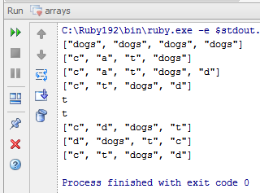
Sorting the Array
Sorting an Array in Ruby is accomplished using the “sort” method. The following will return a sorted array:
new_array.sort
Ruby also allows you to return a reversed sort by using the “reverse” method:
new_array.reverse
Write and Run this Code: Will get these results:
new_array.delete_at(1)
puts new_array.inspect
element_fetch = new_array.fetch(1)
puts element_fetch
element = new_array.at(1)
puts element
sort_array = new_array.sort
reverse_array = new_array.reverse
puts sort_array.inspect
puts reverse_array.inspect
puts new_array.inspect

Slide 10
Iterating through the Array
To iterate through an array you use the “each” method. This will repeat once for each element in the array
new_array.each do |block|
<code>
end
Each iteration will pass the element in the array as a paramenter
You can also use the “each_index” method to pass the index as a parameter instead of the element:
new_array.each_index do |block_index|
puts block_index
end

Slide 11
Other useful Array methods
To see if an array is empty use the “empty?” method. This will return true if the array contains no elements:
new_array.empty?
To see if two arrays are equal you use the “eql?” method. This will return true if both arrays have the same content:
new_array.eql?(sort_array)
You can also see if two arrays are equal by using the “==” operator. This will return true if they contain the same number of elements and if each element is equal to the corresponding element in the other array:
new_array == reverse_array

Slide 12
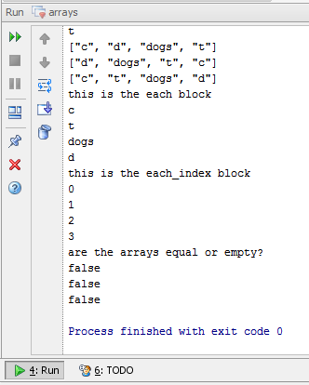
Final Array Code
Write and Run this Code: Will get these results:
puts “this is the each block”
new_array.each do |block|
puts block
end
puts “this is the each_index block”
new_array.each_index do |block_index|
puts block_index
end
puts “are the arrays equal or empty?”
puts new_array.empty?
puts new_array.eql?(sort_array)
puts new_array == reverse_array

Slide 13
Working with Hashes
Hashes can be created using the “new” command:
Hash.new
Ruby has more than one way to create a Hash without using the new method:
new_hash = Hash[“d” => “dog”, “c” => “cat”, ”z” => ”zebra”]
new_hash = {“a” => “ardvark”, “r” => “rhino”, ”l” => ”lemur”}
How big is the Hash?
Hashes use the same “size” method as arrays:
new_hash.size

Slide 14
Adding to the Hash
You can add an element like this:
new_hash[“e”] = “eel”
new_hash[“s”] = “shark”
new_hash[”g”] = ”goldfish”
Or using the store method:
new_hash.store(“h”, “hippo”)
You cannot use the “<<“ operator with Hashes
View the Hash
To display a hash you need to use the “inspect” method which creates a printable version of the hash
new_hash.inspect

Slide 15
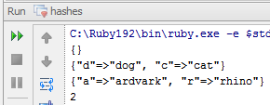
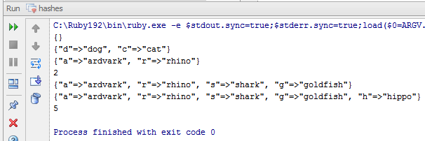
First Hash Code
I would recommend you create a new “hashes.rb” file
Write and Run this Code: Will get these results:
new_hash = Hash.new
puts new_hash.inspect
new_hash = Hash["d" => "dog", "c" => "cat"]
puts new_hash.inspect
new_hash = {"a" => "ardvark", "r" => "rhino"}
puts new_hash.inspect
puts new_hash.size
new_hash["s"] = "shark"
new_hash["g"] = "goldfish"
puts new_hash.inspect
new_hash.store("h", "hippo")
puts new_hash.inspect
puts new_hash.size

Slide 16
Working with Hash Keys
To find the keys in a hash call the “keys” method:
new_hash.keys
To test if a hash has a specific key call the “has_key?(key)” method. Will return true if the given key is present in the hash:
if new_hash.has_key?(“r") then
<code here>
end
You can also test if a hash has a specific value by calling the “has_value?(value)” method. Will return true if the given value is present in the hash:
if new_hash.has_value?(“rhino") then
<code here>
end

Slide 17
Iterating through the Hash
To iterate through a hash you use the “each” method. This will repeat once for each element in the hash:
new_hash.each do |key, value|
<code here>
end
Each iteration will pass the key & value as paramenters
You can also pass only the key as a parameter instead of the element:
new_hash.each_key do |key|
<code here>
end

Slide 18
Accessessing Elements in the Hash
You don’t need to know where in the hash an element is to access it. Simply call it’s key:
new_hash[“s”] #returns the value in the “s” slot
The “fetch(key)” method also works for hashes:
new_hash.fetch(“s”) #returns the value in the “s” slot

Slide 19
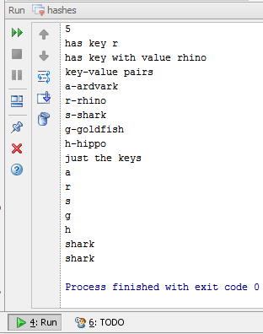
Final Hash Code
Write and Run this Code: Will get these results:
if new_hash.has_key?("r") then
puts "has key r"
end
if new_hash.has_value?("rhino") then
puts "has key with value rhino"
end
puts "key-value pairs"
new_hash.each do |key, value|
puts key + "-" + value
end
puts "just the keys"
new_hash.each_key do |key|
puts key
end
puts "getting values in the s slot"
puts new_hash["s“]
puts new_hash.fetch("s“)

Slide 20
Thank you

